Slide 1
Chapter 6
Some Continuous Probability Distributions

Slide 2
Probability Distributions
Probability Distributions
Ch. 5
Discrete
Probability Distributions
Continuous
Probability Distributions
Ch. 6
Binomial
Normal
Poisson
Uniform
Hypergeometric
Exponential

Slide 3
Continuous Probability Distributions
A continuous random variable is a variable that can assume any value on a continuum (can assume an uncountable number of values)
  thickness of an item
  time required to complete a task
  temperature of a solution
  height, in inches
These can potentially take on any value, depending only on the ability to measure accurately.

Slide 4
The Normal Distribution
Probability Distributions
Continuous
Probability Distributions
Normal
Uniform
Exponential

Slide 5
The Normal Distribution
‘Bell Shaped’
Symmetrical
Mean, Median and Mode
are Equal
Location is determined by the mean, μ
Spread is determined by the standard deviation, σ
The random variable has an infinite theoretical range:
+ ∞ to − ∞
f(X)
σ
X
μ
Mean
= Median
= Mode

Slide 6
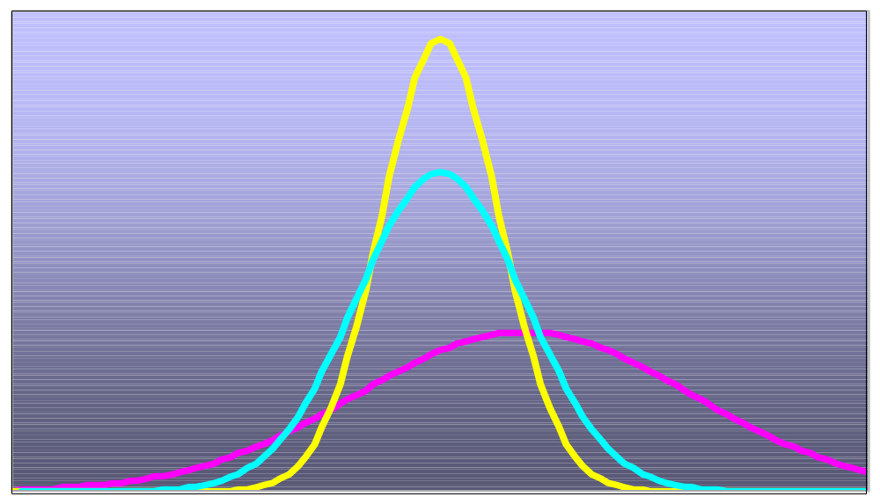
Many Normal Distributions
By varying the parameters μ and σ, we obtain different normal distributions

Slide 7
The Normal Distribution Shape
f(X)
Changing μ shifts the distribution left or right.
Changing σ increases or decreases the spread.
σ
μ
X

Slide 8
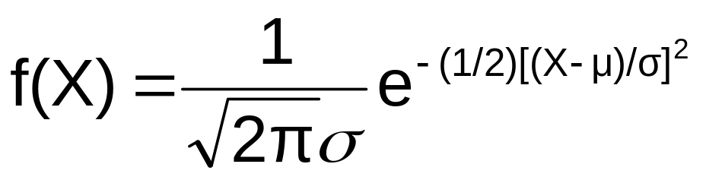
The Normal Probability
Density Function
The formula for the normal probability density function is
Where e = the mathematical constant approximated by 2.71828
π = the mathematical constant approximated by 3.14159
μ = the population mean
σ = the population standard deviation
X = any value of the continuous variable

Slide 9
Finding Normal Probabilities
Probability is the
area under the
curve!
Probability is measured by the area under the curve
f(X)
P
(
≤
≤
)
a
X
b
=
P
(
<
<
)
a
X
b
(Note that the probability of any individual value is zero)
a
b
X

Slide 10


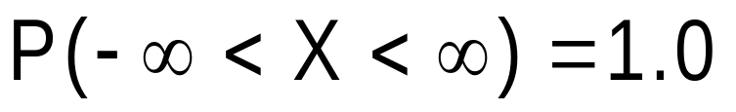
Probability as
Area Under the Curve
The total area under the curve is 1.0, and the curve is symmetric, so half is above the mean, half is below
f(X)
0.5
0.5
μ
X

Slide 11
Empirical Rules
What can we say about the distribution of values around the mean? There are some general rules:
f(X)
μ ± 1σ encloses about 68% of X’s
σ
σ
X
μ-1σ
μ
μ+1σ
68.26%

Slide 12
The Empirical Rule
(continued)
μ ± 2σ covers about 95% of X’s
μ ± 3σ covers about 99.7% of X’s
2σ
2σ
3σ
3σ
μ
x
μ
x
95.44%
99.73%

Slide 13
The Standardized Normal
Any normal distribution (with any mean and standard deviation combination) can be transformed into the standardized normal distribution (Z)
Need to transform X units into Z units

Slide 14
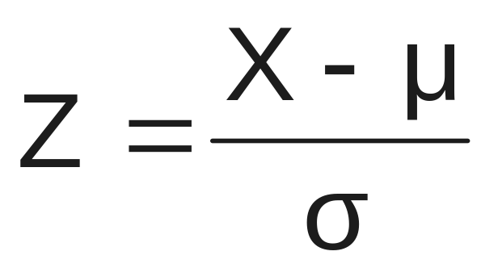
Translation to the Standardized Normal Distribution
Translate from X to the standardized normal (the “Z” distribution) by subtracting the mean of X and dividing by its standard deviation:
The Z distribution always has mean = 0 and standard deviation = 1

Slide 15
The Standardized
Normal Distribution
Also known as the “Z” distribution
Mean is 0
Standard Deviation is 1
f(Z)
1
Z
0
Values above the mean have positive Z-values, values below the mean have negative Z-values

Slide 16
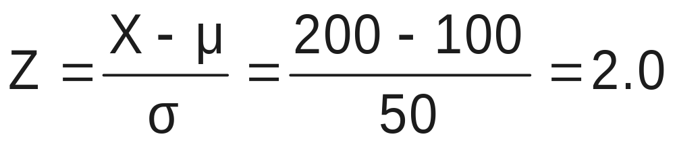
Example
If X is distributed normally with mean of 100 and standard deviation of 50, the Z value for X = 200 is
This says that X = 200 is two standard deviations (2 increments of 50 units) above the mean of 100.

Slide 17
Comparing X and Z units
100
200
X
(μ = 100, σ = 50)
0
2.0
Z
(μ = 0, σ = 1)
Note that the distribution is the same, only the scale has changed. We can express the problem in original units (X) or in standardized units (Z)

Slide 18
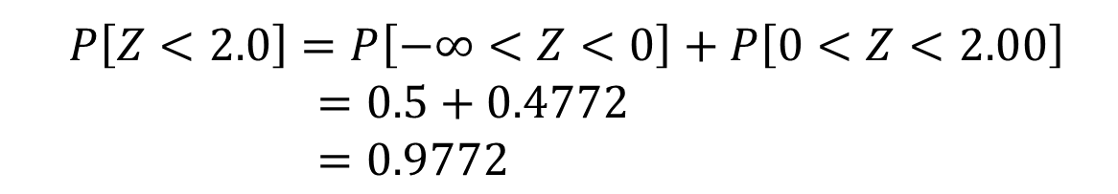
The Standardized Normal Table
0.9772
Example:
P(Z < 2.00) = 0.9772
0
2.00
Z

Slide 19
The Standardized Normal Table
(continued)
The column gives the value of Z to the second decimal point
Z 0.00 0.01 0.02 …
0.0
0.1
The row shows the value of Z to the first decimal point
.
.
.
The value within the table gives the probability from Z = 0 up to the desired Z value
2.0
.4772
P(Z < 2.00) = 0.9772
2.0

Slide 20
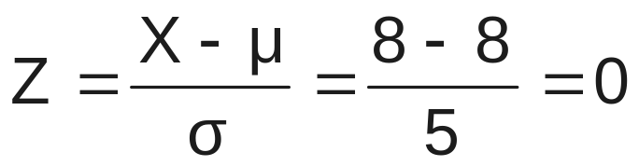
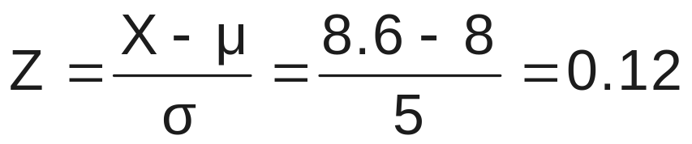
Probability Between
Two Values
Suppose X is normal with mean 8.0 and standard deviation 5.0. Find P(8 < X < 8.6)
Calculate Z-values:
8
8.6
X
0
0.12
Z
P(8 < X < 8.6)
= P(0 < Z < 0.12)
= 0.0478

Slide 21
General Procedure for Finding Probabilities
To find P(a < X < b) when X is distributed normally:
Draw the normal curve for the problem in
terms of X
Translate X-values to Z-values
Use the Standardized Normal Table

Slide 22
Finding Normal Probabilities
Suppose X is normal with mean 8.0 and standard deviation 5.0
Find P(X < 8.6)
X
8.0
8.6

Slide 23
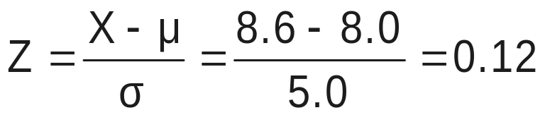
Finding Normal Probabilities
(continued)
Suppose X is normal with mean 8.0 and standard deviation 5.0. Find P(X < 8.6)
μ = 8
σ = 10
μ = 0
σ = 1
8
8.6
X
0
0.12
Z
P(X < 8.6)
P(Z < 0.12)

Slide 24
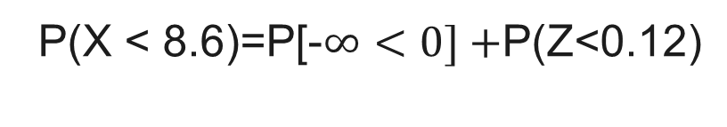
Solution: Finding P(Z < 0.12)
Standardized Normal Probability
Table (Portion)
= 0.5+(Z < 0.12)
=0.5+0.0478
=0.5478
Z
.00
.01
.02
0.0
0.1
.0478
0.2
Z
0.3
0.00
0.12

Slide 25
Upper Tail Probabilities
Suppose X is normal with mean 8.0 and standard deviation 5.0.
Now Find P(X > 8.6)
X
8.0
8.6

Slide 26
Upper Tail Probabilities
(continued)
Now Find P(X > 8.6)…
P(X > 8.6) = P(Z > 0.12) = 0.5 - P(0< Z < 0.12)
= 0.5 - 0.0478 = 0.4522
0.5
0.5 - 0.0478 = 0.4522
Z
Z
0
0
0.12
0.12

Slide 27
Probabilities in the Lower Tail
Suppose X is normal with mean 8.0 and standard deviation 5.0.
Now Find P(7.4 < X < 8)
X
8.0
7.4

Slide 28
Probabilities in the Lower Tail
(continued)
Now Find P(7.4 < X < 8)…
P(7.4 < X < 8)
= P(-0.12 < Z < 0)
= P(0<Z < 0.12)
= 0.0478
0.0478
The Normal distribution is symmetric, so this probability is the same as P(0 < Z < 0.12)
7.4
8.0
X
-0.12
0
Z

Slide 29
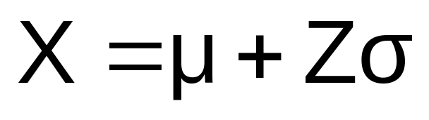
Finding the X value for a Known Probability
Steps to find the X value for a known probability:
1. Find the Z value for the known probability
2. Convert to X units using the formula:

Slide 30
Evaluating Normality
Not all continuous random variables are normally distributed
It is important to evaluate how well the data set is approximated by a normal distribution

Slide 31
Evaluating Normality
(continued)
Construct charts or graphs
  For small- or moderate-sized data sets, do stem-and-leaf display and box-and-whisker plot look symmetric?
  For large data sets, does the histogram or polygon appear bell-shaped?
Compute descriptive summary measures
  Do the mean, median and mode have similar values?
  Is the interquartile range approximately 1.33 σ?
  Is the range approximately 6 σ?

Slide 32

Assessing Normality
(continued)
Observe the distribution of the data set
  Do approximately 2/3 of the observations lie within mean 1 standard deviation?
  Do approximately 80% of the observations lie within mean 1.28 standard deviations?
  Do approximately 95% of the observations lie within mean 2 standard deviations?
Evaluate normal probability plot
  Is the normal probability plot approximately linear with positive slope?

Slide 33
The Normal Probability Plot
(continued)
A normal probability plot for data from a normal distribution will be approximately linear:
X
90
60
30
-2
-1
0
1
2
Z

Slide 34
Normal Probability Plot
(continued)
Left-Skewed
Right-Skewed
X
90
X
90
60
60
30
30
-2
-1
0
1
2
Z
-2
-1
0
1
2
Z
Rectangular
Nonlinear plots indicate a deviation from normality
X
90
60
30
-2
-1
0
1
2
Z

Slide 35
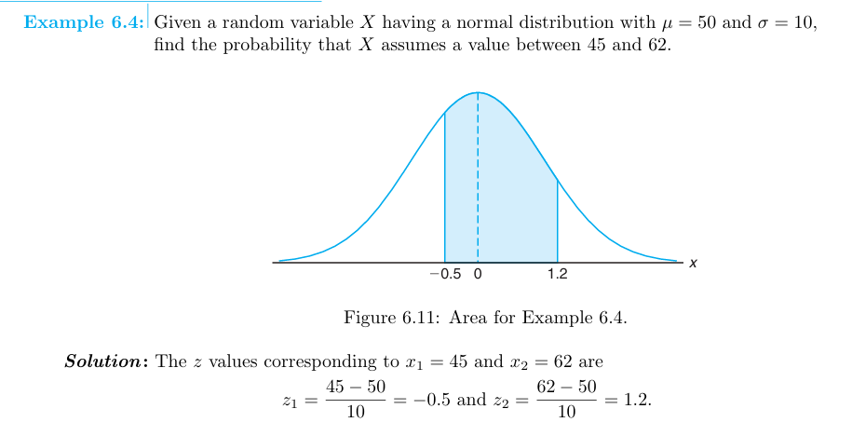
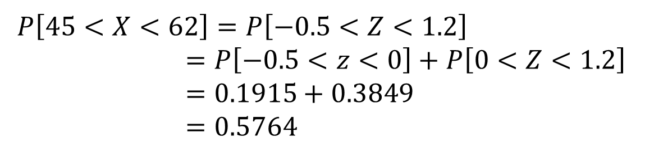

Slide 36
Practice question
Pg 187
Q (6.16, 6.18, 6.19, 6.20, 6.21, 6.23)

